Slide 1
The School-to-Prison-Pipeline
Making a difference to
Keep kids in school and out of prison

Slide 2
Are kid really being pushed out of school and into jail?

Slide 4
Well…
FLORIDA can’t be that bad…right?

Slide 5
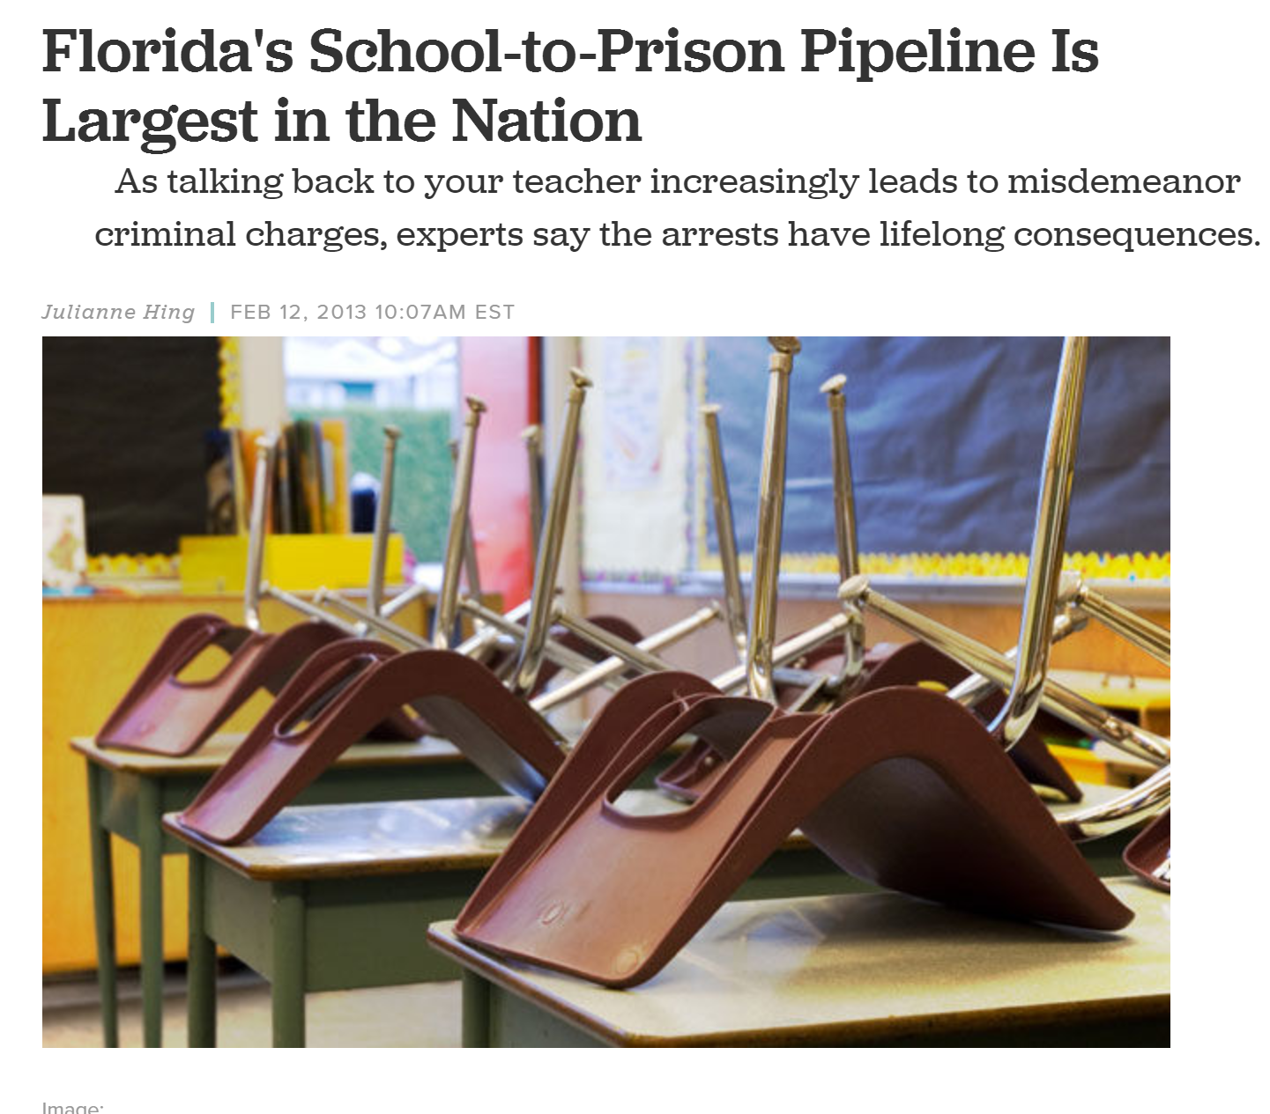

Slide 6
Florida by the numbers…
Latest numbers from the Office for Civil Rights:
Arrests at school: 1,768
School referrals to law enforcement: 16, 747
Over 18,000 students were arrested from school

Slide 7
According to FL DJJ, here’s the arrests…

Slide 8
Some counties are better than others…

Slide 9
What about kids in Dependency?
If a child is in both the Dependency and Delinquency system, they are known as “Crossover kids” because they have crossed from one system into the other.
There are currently approximately 1,000 Crossover kids in Florida.
Kids in Dependency are particularly vulnerable to being arrested for “status offenses” (behaviors that are only criminal for people with a certain status, such as age). Truancy, underage possession, running away, incorrigibility.
Conflict in group homes can lead to domestic violence charges.
They are also statistically more likely to be suspended or arrested at school.

Slide 10
So, we know that kids are being arrested in large numbers…
but what the heck is the school-to-prison pipeline and what does it have to do with me?

Slide 11
The School-to-Prison-Pipeline
The School-to-Prison Pipeline is a metaphor for a widely known set of dynamics that push students from school into prison each year.
Kids in Dependency are particularly vulnerable to these dynamics
Your advocacy can do a lot towards stopping those dynamics

Slide 12
What are those dynamics?
The three most common dynamics are:
1. Zero tolerance policies and school district’s overuse of suspension for minor (often disability-related) behaviors,
2. School district’s overuse of law enforcement in dealing with behaviors and
3 School district’s underuse of federally mandated supports and services for students, especially for those with disabilities.
ll three of these dynamics are discriminatory and lead to devastating outcomes for students with disabilities.

Slide 13
Factor 1
Zero Tolerance and Suspensions

Slide 14
Zero Tolerance Policies and Suspension
Zero tolerance policies requires school officials to hand down specific, consistent, and harsh punishment—usually suspension or expulsion—when students break certain rules regardless of the circumstances.
FLDOE: The Legislature finds that zero-tolerance policies are not intended to be rigorously applied to petty acts of misconduct and misdemeanors, including, but not limited to, minor fights or disturbances. The Legislature finds that zero-tolerance policies must apply equally to all students regardless of their economic status, race, or disability.

Slide 15
Zero Tolerance Policies and Suspension con’t
According to the U.S. Department of Education, Office for Civil Rights Data Collection (“CRDC”), over 2.8 million students were suspended at least once during the 2013-14 school year, the last year for which data was available.
Students with disabilities were disproportionately represented in that number and were twice as likely as their typical peers to be both suspended and/or arrested.
Black males made up one-half of all students suspended although they only represent 8% of the overall population. Black males who were disabled were overwhelmingly the most likely to be suspended

Slide 16
Suspensions Matter
According to a study by Johns Hopkins University (2013)…
Florida 9th graders who were never suspended out of school as freshmen have a 75% graduation rate.
Those who are suspended once, have a 52% graduation rate.
Those suspended twice have a 38% rate for graduation.

Slide 17
What are the academic effects of suspension?
Multiple university-directed research studies show:
Further academic regression
Further disengagement from academics
Increases the likelihood of additional poor school behavior
Increases the likelihood of future suspensions
Increases the likelihood of dropping out
Increases the likelihood that community legal involvement from unsupervised time out of school
Students with emotional, behavioral, or learning disabilities who are more likely to be suspended than students without disabilities, continue to have increasingly serious negative outcomes

Slide 18
Long Term Effects of Suspension
“A suspension can be life altering. It is the number-one predictor – more than poverty – of whether children will drop out of school, and walk down a road that includes greater likelihood of unemployment, reliance on social-welfare programs, and imprisonment.” – The School-to-Prison Pipeline: Time to Shut It Down, eaToday (Jan. 5, 2015)

Slide 19
What is the financial cost of dropping out?
A study from the Center for Civil Rights Remedies (CCRR) at the Civil Rights Project at UCLA finds that student suspensions cost the nation more than $35 billion in lost tax revenue and increased social expenditures combined.
The CCRR report estimates that school suspensions contribute to 67,735 additional high school dropouts nationwide for one cohort of tenth-grade students.
Multiply that with tenth-grade cohorts from additional years and costs easily exceed $100 billion.”
https://all4ed.org/articles/the-suspension-effect-exclusionary-discipline-practices-increase-high-school-dropout-rates-and-cost-the-nation-billions-in-lost-tax-revenue-according-to-the-center-for-civil-rights-remedies/

Slide 20
Further costs associated with dropping out…
Dropouts earn more than $330,000 less in a lifetime than high school graduates (Georgetown University)
Each individual dropout costs the nation more than $163,000 in lost tax revenue in their lifetime, amounting to an $11 billion fiscal impact nationally, according to the report
Each dropout incurs more than $364,000 in social expenditures as well, such as increased health care expenses, that cost society a total of more than $24 billion
A 1 percentage-point reduction in the national suspension rate would save the nation $2.2 billion in fiscal and social losses over the lifetimes of those individuals
Cutting the suspension rate in half would result in $17.8 billion in savings, including $5.5 billion in additional tax revenue, $2 billion in health savings, and $3 billion in crime savings
https://all4ed.org/articles/the-suspension-effect-exclusionary-discipline-practices-increase-high-school-dropout-rates-and-cost-the-nation-billions-in-lost-tax-revenue-according-to-the-center-for-civil-rights-remedies/

Slide 21
Factor 2
The overuse of Law Enforcement in the schools

Slide 22
The Overuse of Law Enforcement in the Schools

Slide 23
2017
47% of all schools have some kind of law enforcement officer present.

Slide 24
Why?

Slide 25
Sadly…
School resource officers have not effectively stopped any of these shootings, nor have they been shown to improve school safety.
Despite this, funding for police presence for schools has increased exponentially.

Slide 26
Another concern…

Slide 27
What Does Improve School Safety?
Identifying students with behavioral and mental health concerns
Supporting students who have behavioral and mental health needs
Training staff to identify students who may be struggling
Developing valid anti-bullying curriculum and district procedures

Slide 28
Factor 3
The Underuse of supports and services for students with disabilities

Slide 29
The Underuse of Appropriate Programs for Students with Disabilities.
Florida:
In 2013-14 (last year for federal data collection) there were over 47,300 children with disabilities suspended from school, and 108 children with disabilities expelled.
Students with disabilities are more than twice as likely as typical peers to be suspended or expelled.
Black children with disabilities are between three and five times more likely to be suspended as typical peers for the same infraction, in alignment with national averages

Slide 30
What are the effects of suspension on kids with disabilities?
If a child is suspended or arrested, they are excluded from educational opportunities.
For most students with a disability, the missed instruction does not address the underlying cause of why they felt the need to misbehave; it simply adds to their already burdensome academic challenges.
Each further exclusion, through either suspension or arrest, leads to more statistically significant negative outcomes.
A vicious cycle occurs: initial minor incident leads to a suspension/arrest, leads to getting even further behind in school, leads to the need for even more support upon returning, leads to even further student frustration and disengagement, eventually leading to the student finally dropping out of school and/or ending up in jail or prison.
Kids with disabilities are the most likely to enter the STPP.

Slide 31
What about kids in Dependency?
Kids in Dependency are also among the most likely to enter the STPP and become “Crossover kids”.
Transitions, lack of educational and familial support mean many kids in are educationally disadvantaged to begin with
Trauma, abuse and neglect often lead to the behavioral issues triggering suspensions and arrests
Due to multiple transitions, kids in dependency are often not identified as being students with disabilities

Slide 32
What can you do to help stop the School-to-Prison-Pipeline?
A Lot!

Slide 33
Advocate, Advocate, Advocate
Suspensions may mean an unidentified disability area
Kids with learning disorders avoid school or “check out”
Kids exposed to trauma, abuse and neglect often manifest trauma as a behavioral disorder
Kids in Dependency often don’t have parents, caretakers who have advocated for them
Kids in Dependency often lack a historian who sees the long-term struggles they often have
Arrests at school may mean that a student with a disability is not receiving appropriate services.

Slide 34
You Have the Power Use it!

Slide 35
QUESTIONS?
Please feel free to send any questions regarding this webinar to: edu.advocacy@gal.fl.gov
Once you have completed the webinar, please email training@gal.fl.gov to receive your certificate.

